Slide 1

STACK
Dr Shatarupa Dash

Slide 2
Stack
Applications of Stack
Stack is an ordered list
Insertion and deletion can be performed only at one end called top.
Stacks are sometimes called as Last-In-First-Out (LIFO)
lists i.e. the element which is inserted first in the stack, will be deleted last from the stack.
Recursion
Expression evaluations and conversions
Parsing
Tree Traversals

Slide 3
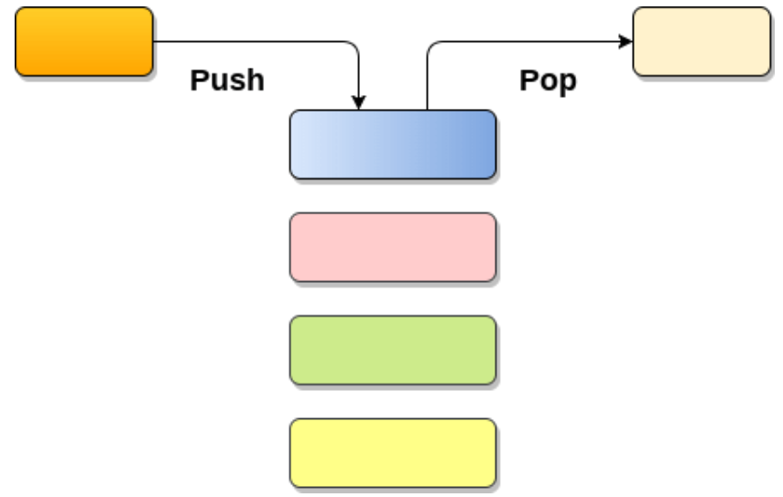
OPERATION ON STACK

Slide 4
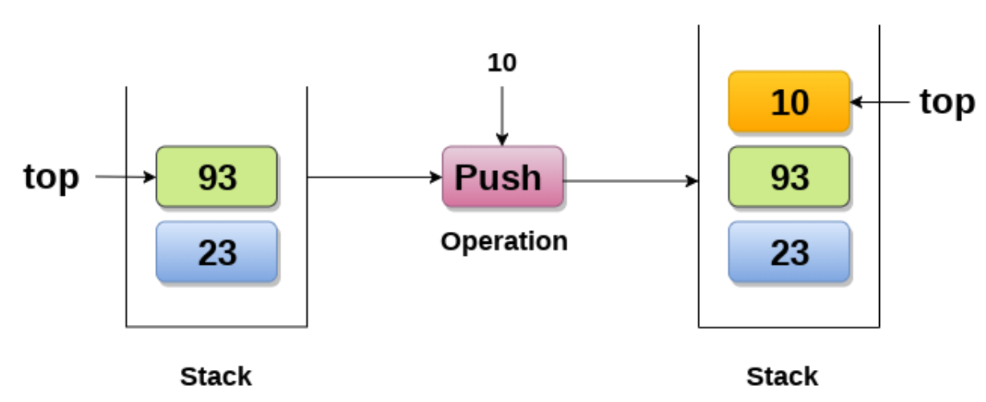
Push : Adding an element onto the stack

Slide 5
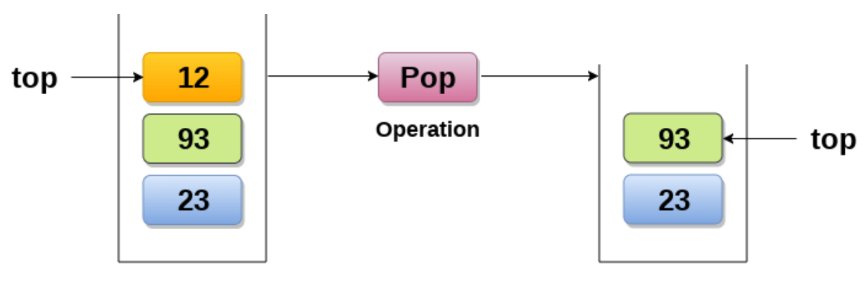
Pop : Removing an element from the stack

Slide 6
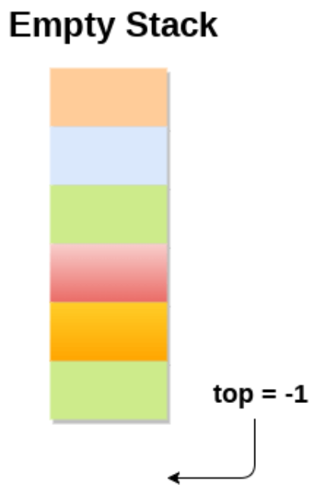
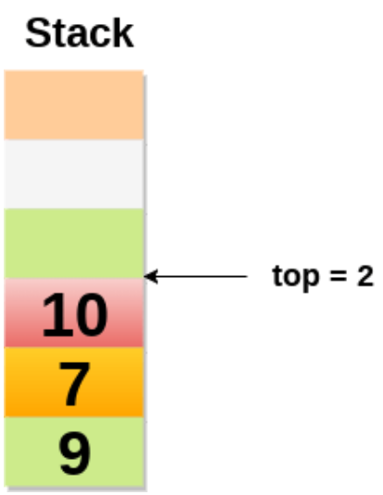
The stack is called empty if it doesn't contain any element inside it. At this stage, the value of variable top is -1.

Slide 7
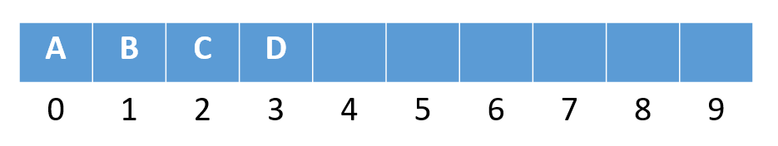
A | B | C | D
0 | 1 | 2 | 3 | 4 | 5 | 6 | 7 | 8 | 9

Slide 8
public static boolean isEmpty(int top)
{
if(top==-1)
return true;
else
return false;
}
TOP=-1
0 | 1 | 2 | 3 | 4 | 5 | 6 | 7 | 8 | 9

Slide 9
public static boolean isFull(int top)
{
if(top==MAX)
return true;
else
return false;
}
Top==Max
1 | 11 | 22 | 33 | 44 | 55 | 66 | 77 | 88 | 99
0 | 1 | 2 | 3 | 4 | 5 | 6 | 7 | 8 | 9

Slide 10
public static int push(int S[],int top){
if(isFull(top))
System.out.println("Stack is Full!");
else
{
Scanner sc=new Scanner (System.in);
System.out.println("Enter element");
int ele= sc.nextInt();
top++;
S[top]=ele;
}
return top;
}
Top was 3
Insert here
01 | 11 | 22 | 33
0 | 1 | 2 | 3 | 4 | 5 | 6 | 7 | 8 | 9

Slide 11
public static int pop(int S[],inttop){
if(isEmpty(top))
System.out.println("Underflow!");
else
{
int ele= S[top];
top--;
System.out.println("Deleted Element is "+ele);
}
return top;
}
New top
Delete this
1 | 11 | 22 | 33 | 44
0 | 1 | 2 | 3 | 4 | 5 | 6 | 7 | 8 | 9

Slide 12
public static void display(int S[],int top){
if(isEmpty(top))
System.out.println("Stack is Empty!");
else{
System.out.println("Elements in stack.");
for(int i=top;i>=0;i--)
System.out.println(S[i]);
}

Slide 13
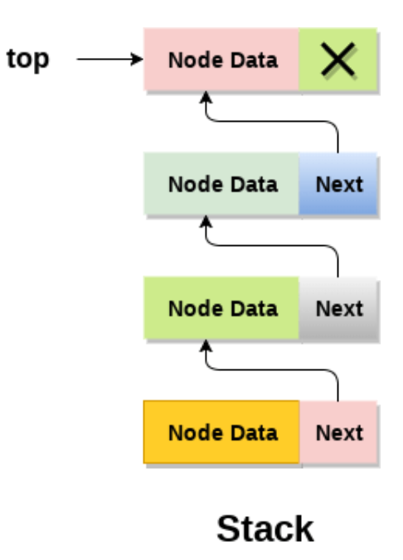
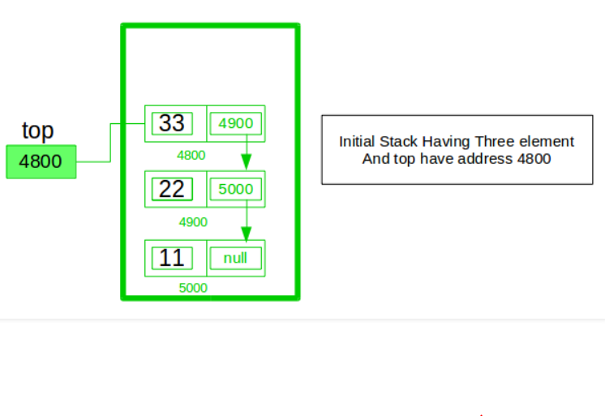
Linked list implementation of stack

Slide 14
Push operation
public static Node push(Node top){
Scanner sc=new Scanner(System.in);
Node p=new Node();
p.info=sc.nextInt();
if(top==null){
top=p;
p.next=null;
}
top
00
p
top
11
00
else{
p.next=top;
top=p;
}
return top;
}
2
1
22
p

Slide 15
Pop operation
public static Node pop(Node top){
System.out.println("Element to be deleted :” + top.info);
top=top.next;
return top;
}
top
11
00

Slide 16
public static void display(Node top){
Node s=top;
if(top==null)
System.out.println("List is empty.");
else{
System.out.println("List Created:");
while(s!=null){
System.out.print("Info.- "+s.info+" -> ");
s=s.next;
}
} }

Slide 17
Stack Applications
Stacks can be used for expression evaluation.
Stacks can be used to check parenthesis matching in an expression.
Stacks can be used for Conversion from one form of expression to another.
Stacks can be used for Memory Management.
Stack data structures are used in backtracking problems.

Slide 18
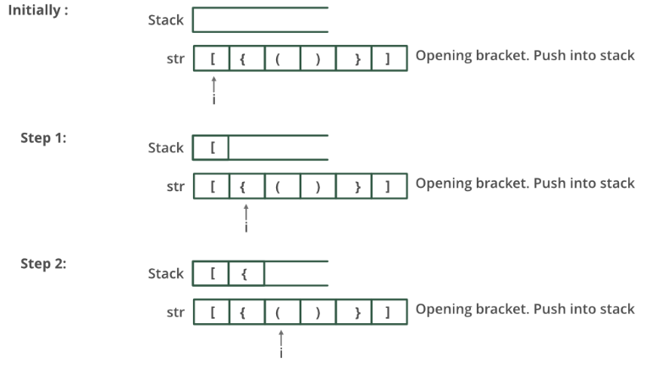
Matching Parenthesis

Slide 19
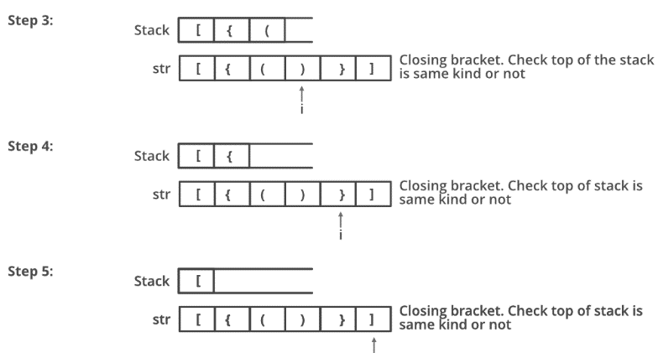
Matching Parenthesis

Slide 20
static class stack
{
int top=-1;
char items[] = new char[100];
void push(char x)
{ if (top == 99)
System.out.println("Stack full");
else
items[++top] = x; }
char pop()
{ f (top == -1)
{ System.out.println("Underflow error");
return '\0'; }
else
{ char element = items[top];
top--;
return element; }//It is different than earlier code
}

Slide 21
static boolean isMatchingPair(char character1, char character2)
{
if (character1 == '(' && character2 == ')')
return true;
else if (character1 == '{' && character2 == '}')
return true;
else if (character1 == '[' && character2 == ']')
return true;
else
return false;
}

Slide 22
static boolean areParenthesisBalanced(char exp[])
{ stack st=new stack();
for(int i=0;i<exp.length;i++)
{
if (exp[i] == '{' || exp[i] == '(' || exp[i] == '[')
st.push(exp[i]);
if (exp[i] == '}' || exp[i] == ')' || exp[i] == ']')
{
if (st.isEmpty())
return false;
else if ( !isMatchingPair(st.pop(), exp[i]) )
return false;
}
}

Slide 23
if (st.isEmpty())
return true;
else
return false;
}
public static void main(String[] args)
{
char exp[] = {'{','(',')','}','[',']'};
if (areParenthesisBalanced(exp))
System.out.println("Balanced ");
else
System.out.println("Not Balanced ");
}
}

